Slide 1
Data:
Distribution of depression labels among each patient/individual
Overlapping of sleep labels
Feature extraction:
Spectral envelope and optimal scaling (Li et al 2021)
Classifier:
Gaussian processes?

Slide 2
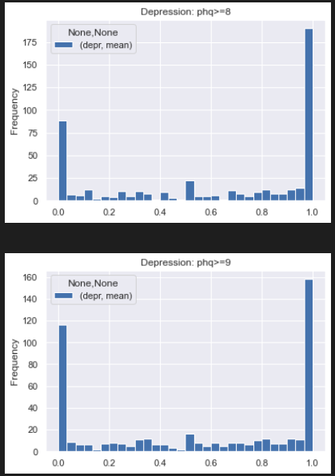
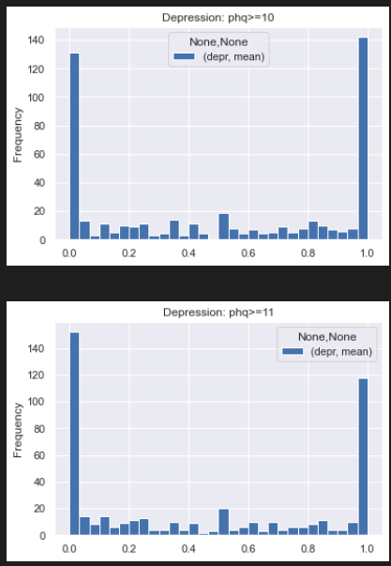
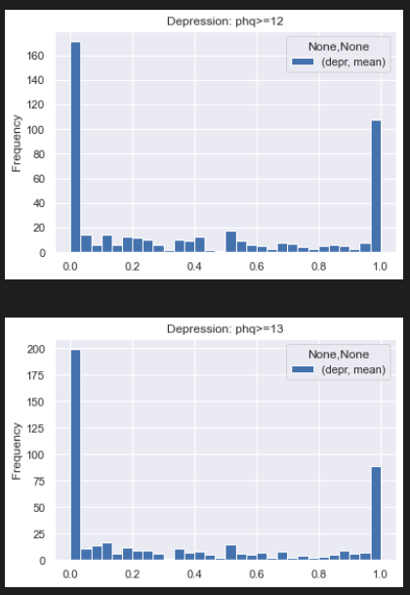

Slide 3
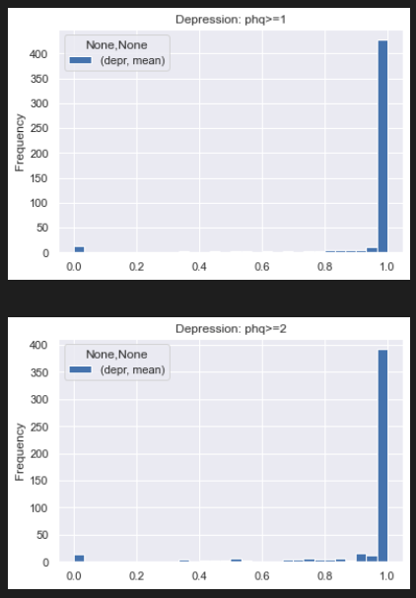
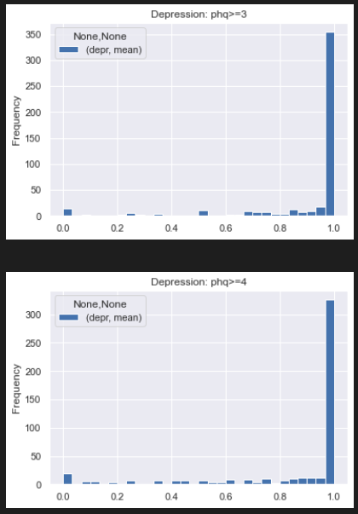
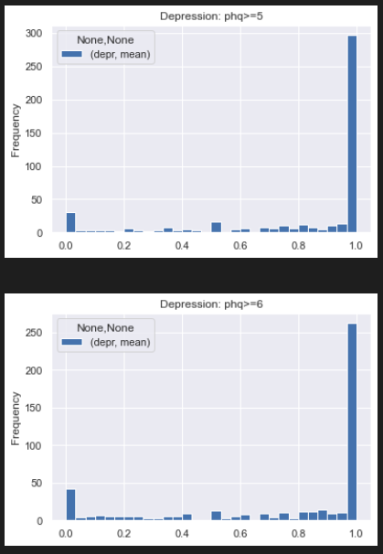
1-6

Slide 4
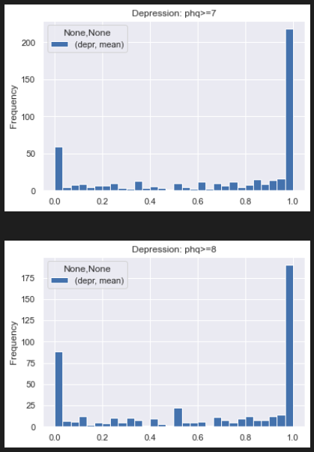
7-8

Slide 5
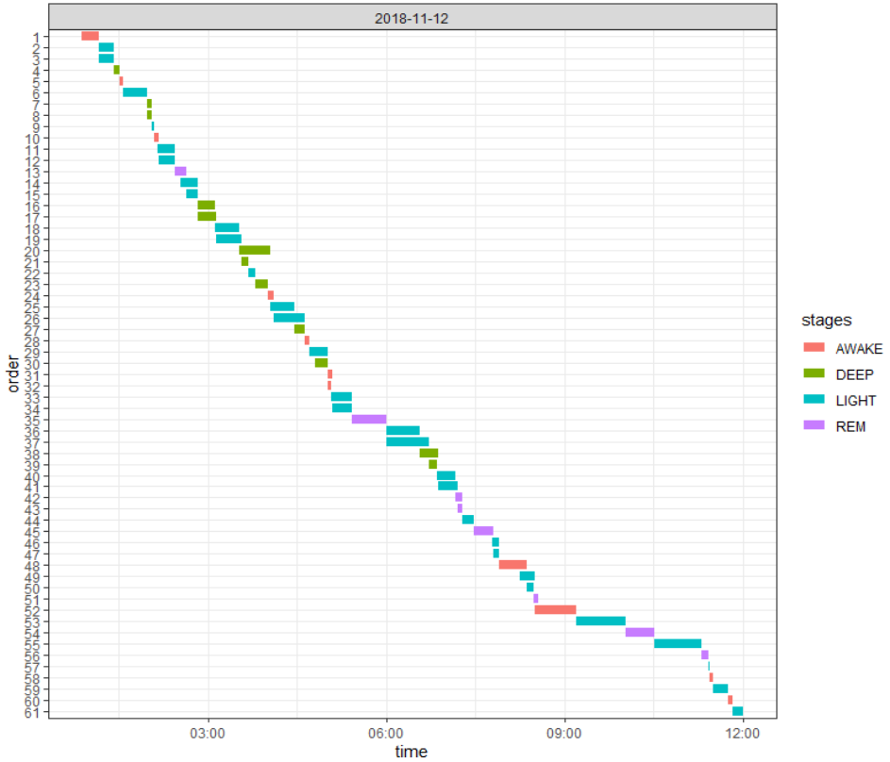
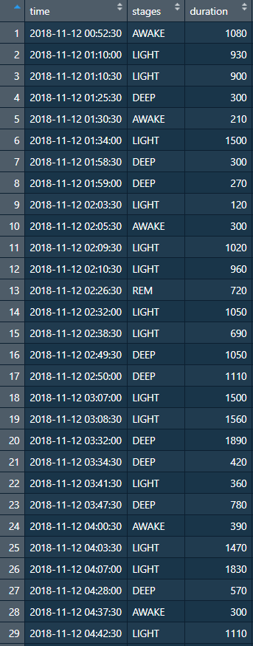
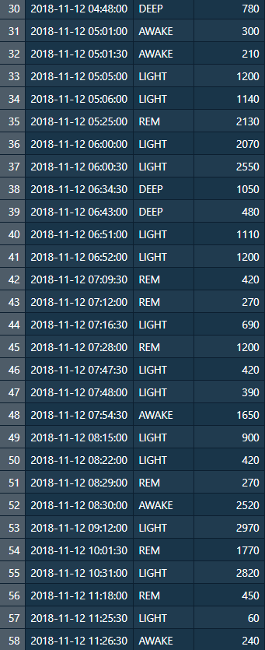
PID: 3c6671b8-45ae-4552-b92b-934ec6bbb89f

Slide 6
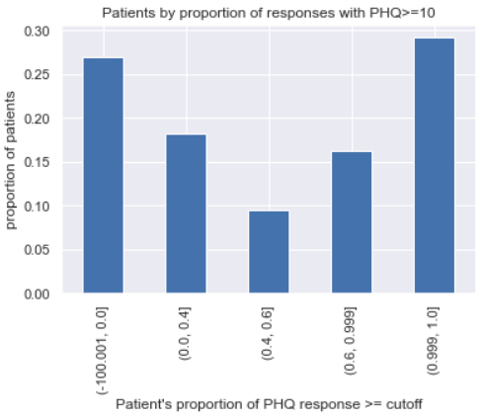
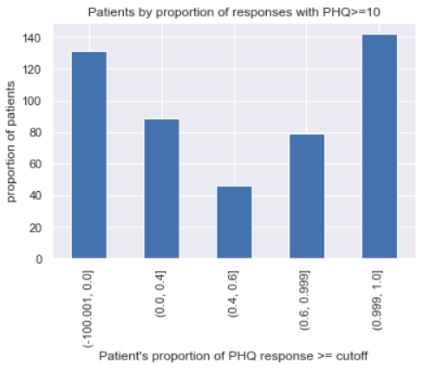

Slide 7
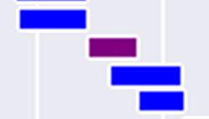
Less 0.5% of measured timestamps have >1 (duplicated) label
Only 122 out of 461 subjects have duplication issue
Depth =
1
2
2

Slide 8
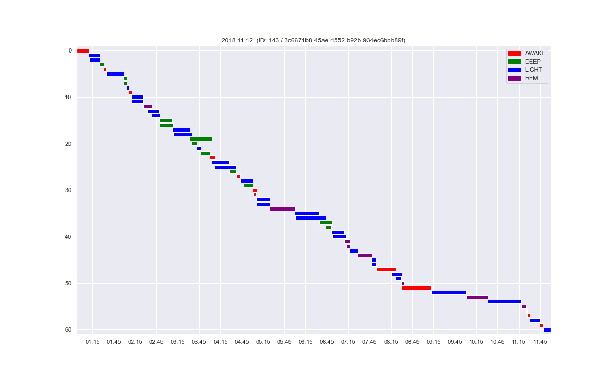
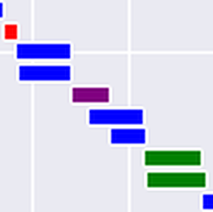
Before dedup

Slide 9
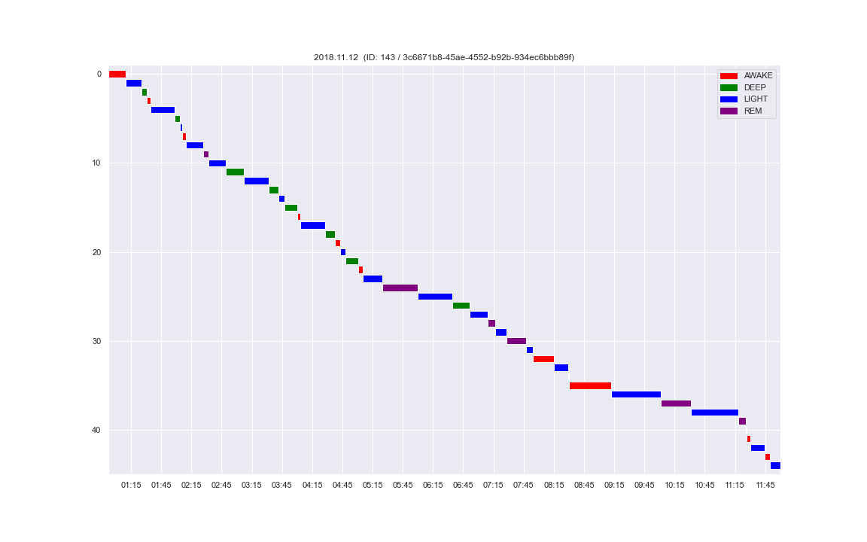
After dedup

Slide 10
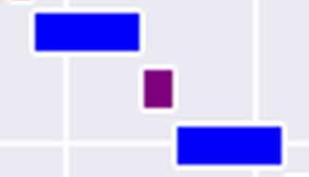
Hard-to-resolve situations
→`
→
→
Before dedup
After dedup

Slide 11
Other issues
Patient IDs in PHQ and sleep stages – some are non-existent in meta-data file

Slide 12
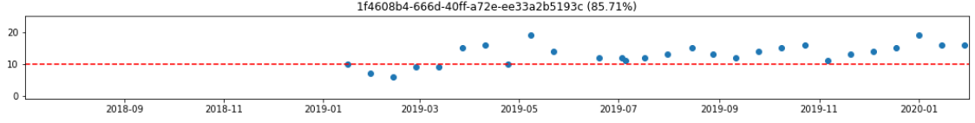
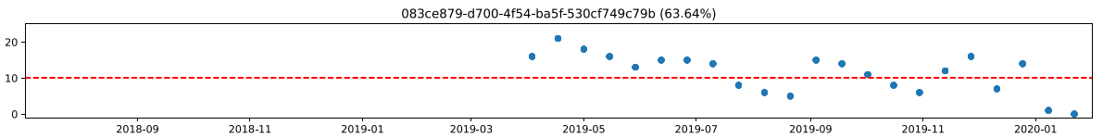
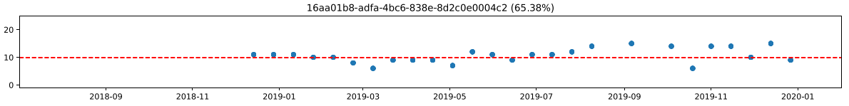
PHQ trajectories
Duplicate records
High/low variability in trajectories
MSc Project • 2022.02.10 updates

Slide 13
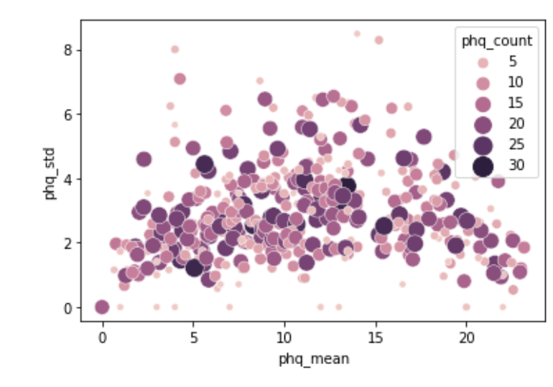
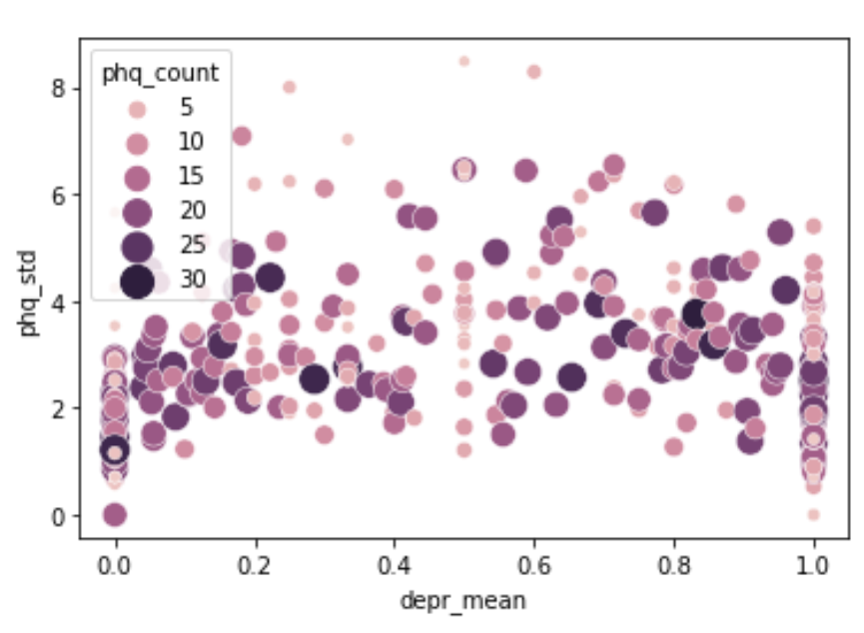

Slide 14
Outlook
Match by date
Run simple logistic model
Run empty mixed model vs non-mixed model
MSc Project • 2022.02.10 updates

Slide 15
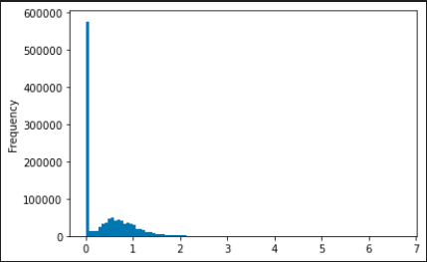
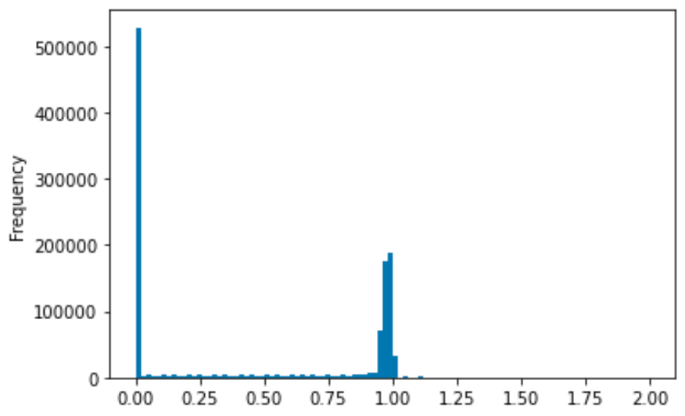
Preprocessing
Input dataframe: Each row = hour
Each column = proportion of sleep stage (awake/deep/light/rem)
Expected:
‘total’ sleep stage proportion per hour = 1
Accounting for missing values, 0 <= ‘total’ proportion <= 1
Problem: A significant number of hours (12.1%) show a ‘total’ proportion of >1
Many rows
Before: Distribution of hourly sleep stage proportions
After: Distribution of hourly sleep stage proportions
Total proportion=0 (entirely missing): 43.6%
MSc Project • 2022.03.02 updates

Slide 16
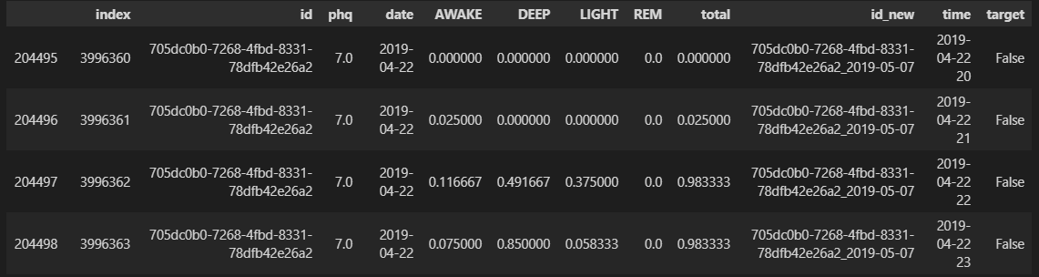
Preprocessing
Example input
MSc Project • 2022.03.02 updates

Slide 17
Preprocessing
Sleep stage intervals (n=1,855,957, 618,082 hours)
PHQ test records (n=5082)
Remove records from subjects unmatched in PHQ/metadata (n=57728, 3.11%)
Remove records from subjects unmatched in sleep data/metadata (n=233, 4.58%)
Sleep stage 30s timestamps (n=70,190,672)
PHQ test records (n=4849)
Remove timestamps outside 8pm-10am (n=2,932,777, 4.18%)
Deduplication (n=258,575, 0.38%)
Binning
Hourly-binned proportions (n=735555)
Merged
X (hourly proportions) Depressed: 414000 (56.28%) Non-depressed: 321555 (43.72%)
Target (PHQ test result covering 14-days) Depressed: 1725 (55.24%) Non-depressed: 2129 (44.76%)
MSc Project • 2022.03.02 updates

Slide 18
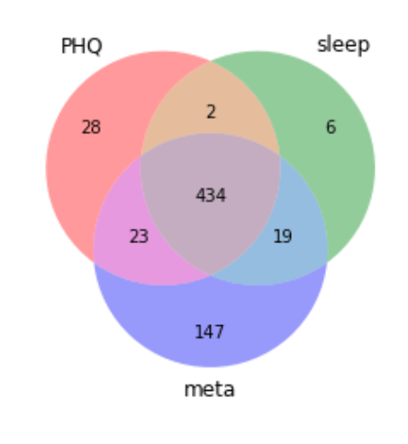
Preprocessing
Subject IDs in three data sources
MSc Project • 2022.03.02 updates

Slide 19
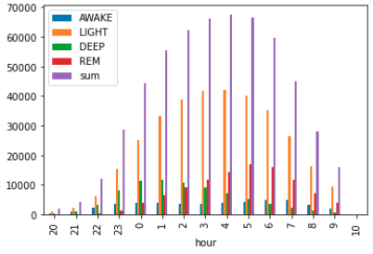
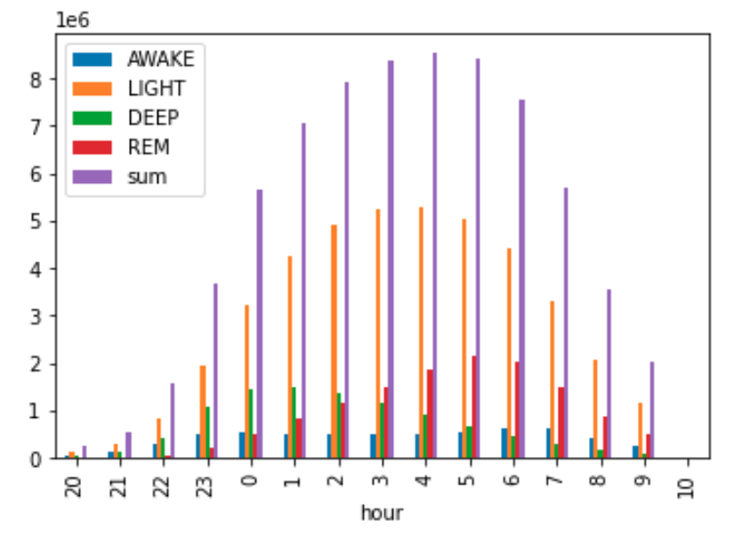
Preprocessing
Distribution of recorded sleep data by hour (8pm-10am)
MSc Project • 2022.03.02 updates

Slide 20
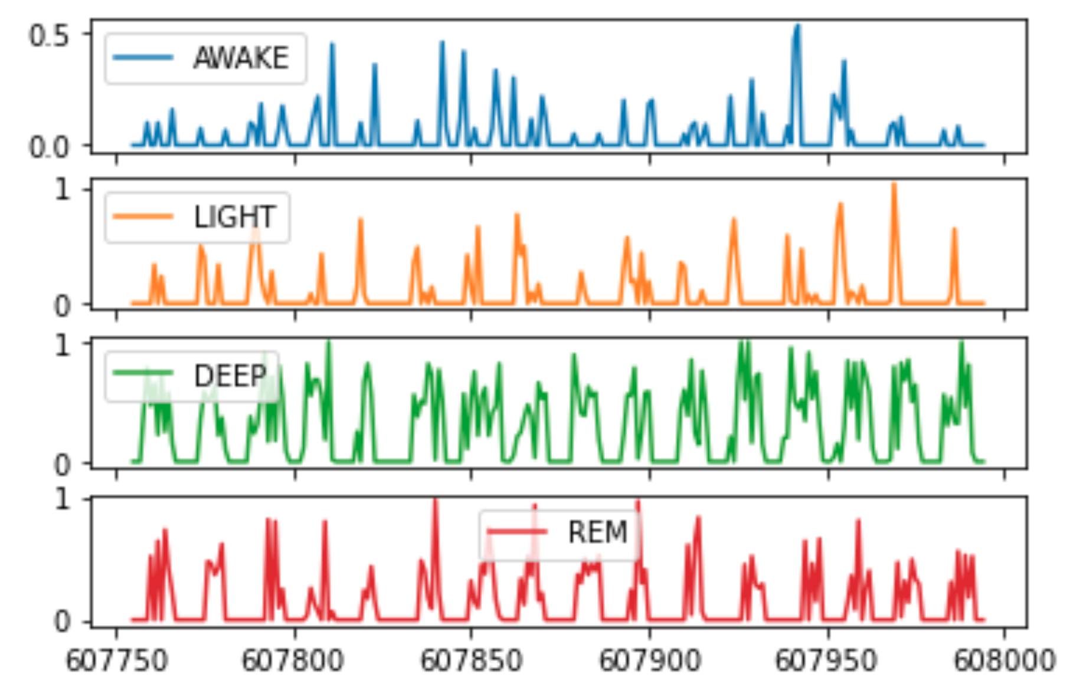
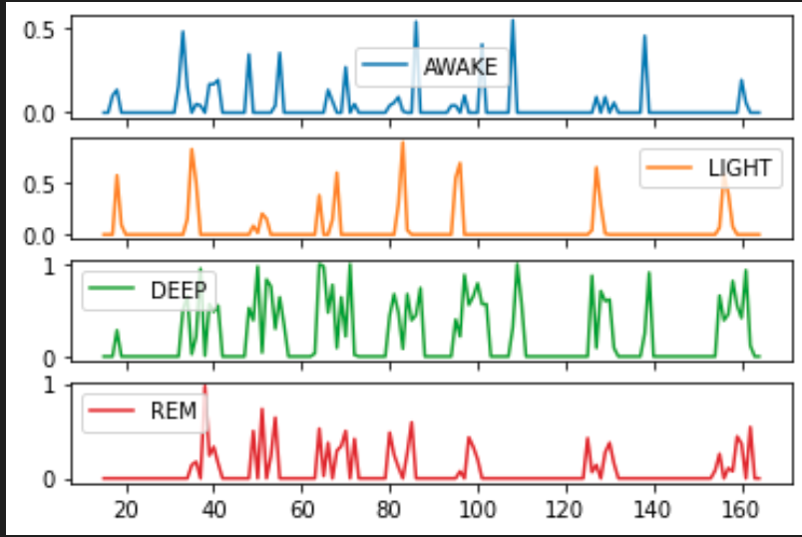
Feature extraction
Preview of input time series
Non-depressed
Depressed
show = df.loc[df['id_new']=='6fcdd023-6388-4650-a30d-8311015fc731_2019-05-08'] # non-depressed
show2 = df.loc[df['id_new']=='bf3defd7-2a52-4557-8202-9d887957e109_2019-02-04'] # depressed, same subject
MSc Project • 2022.03.02 updates

Slide 21
Title
Subtitle
- PCA and ICA taken jointly did not improve performance
- Feature transformation methods lower interpretability
- Different feature subsets give similar performance --> suggests the presence of different Markov Blankets
- i.e. "there may be different underlying combinations of features which essentially can jointly capture" the key characteristics for class separation”
Code
MSc Project • 2022.03.02 updates

Slide 22
Preprocessing
Current issues (fix later):
Probably dump 10am instead of keeping it
A few hours still have ‘total’ proportion > 1, reason unknown
RF classifier show terrible performance – need to double check preprocessing
Need to double check deduplication logic – is the code working as intended?
Code:
Routines
Bar plot with percentages
Anything else?
Understanding
pandas index
pandas datetime
MSc Project • 2022.03.02 updates

Slide 23
Pipeline
Baseline models
tsFresh
After filtering by non-missing days >= 12, number of deltaT = 2860
Feature Extraction: 3156 features
Feature Selection: 422 features
Train-test-split (not stratified by subject):
Training Features Shape: (858, 422)
Training Labels Shape: (858,)
Testing Features Shape: (2002, 422)
Testing Labels Shape: (2002,)
Testing proportion: 379 T – 479 F (44.1%)
Training proportion: 853 T – 1149 F (42.6%)
Preprocessing + Models + Tuning:
StandardScaling + KNN
StandardScaling + SVM classifier
No scaling + RandomForest
No scaling + LogisticRegression and regularized variants
MSc Project • 2022.03.24 updates

Slide 24
Tuning results on training set
Baseline models
### knn
Best score: 0.6361371153306452
Best params: {'knn__n_neighbors': 9}
### svc
Best score: 0.644029916331013
Best params: {'svc__C': 10, 'svc__gamma': 0.001, 'svc__kernel': 'rbf'}
### rf
Best score: 0.6363237836379443
Best params: {'rf__max_depth': 20, 'rf__max_features': 'auto', 'rf__min_samples_split': 2, 'rf__n_estimators': 200}
### logistic
Best score: 0.6189314284232641
Best params: {'logistic__C': 0.1, 'logistic__penalty': 'l1', 'logistic__solver': 'liblinear
MSc Project • 2022.03.24 updates

Slide 25
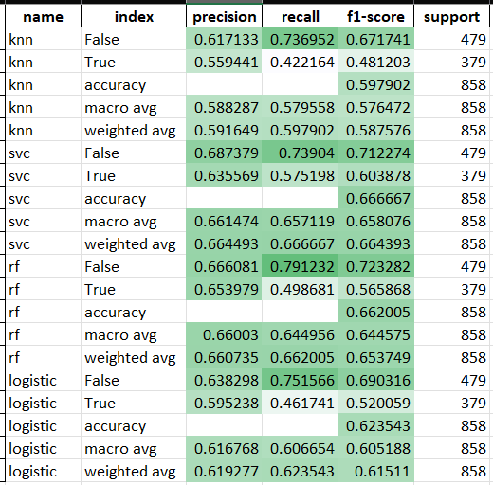
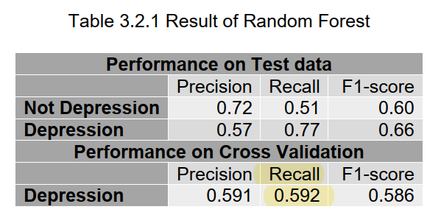
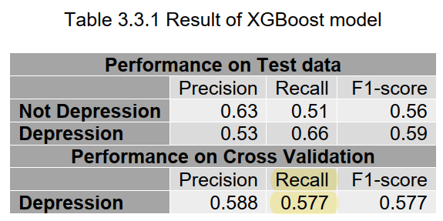
Performance on test set
Baseline models
MSc Project • 2022.03.24 updates

Slide 26
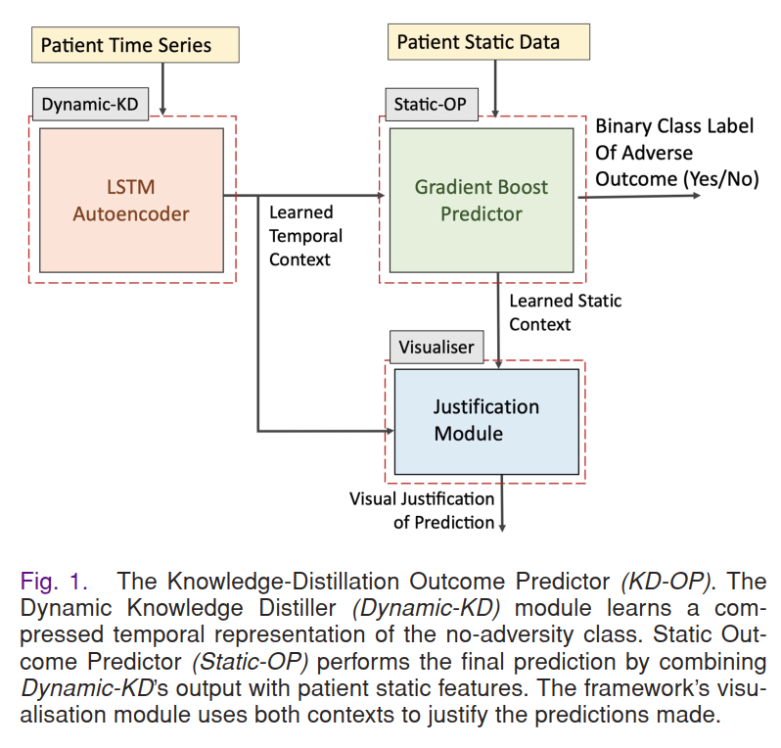
How to consider mixed effects?
Research idea
Time series
“Static” data
multiple levels to consider
Week level
Subject level
(3) ‘Stability’ of sleep? Standard deviations of some metrics?
MSc Project • 2022.03.24 updates

Slide 27
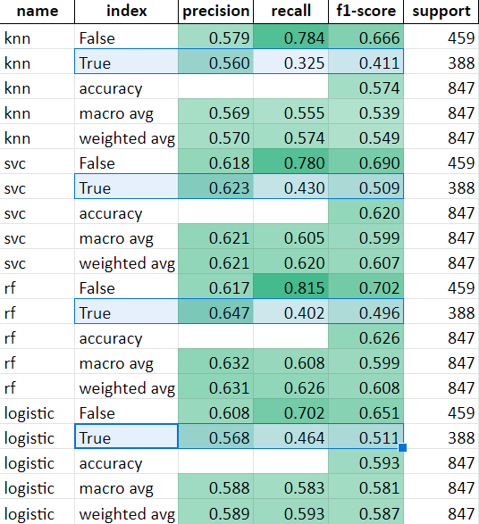
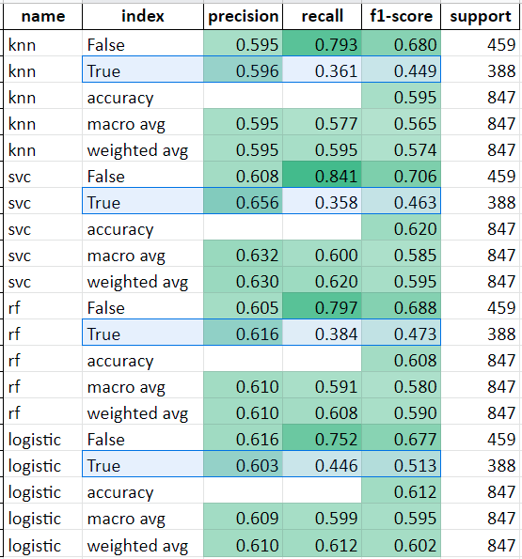
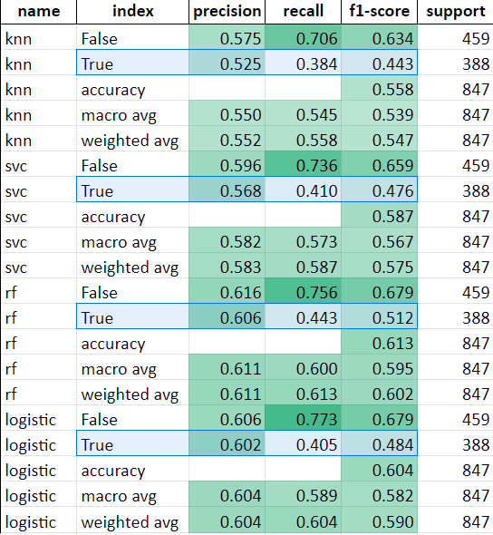
Rerunning baseline models with participants stratified
Baseline models
tsfresh feature selection
Collinear features removed (VIF<5)
Select k-best features (ANOVA f-classification score)
MSc Project • 2022.04.11 updates

Slide 28
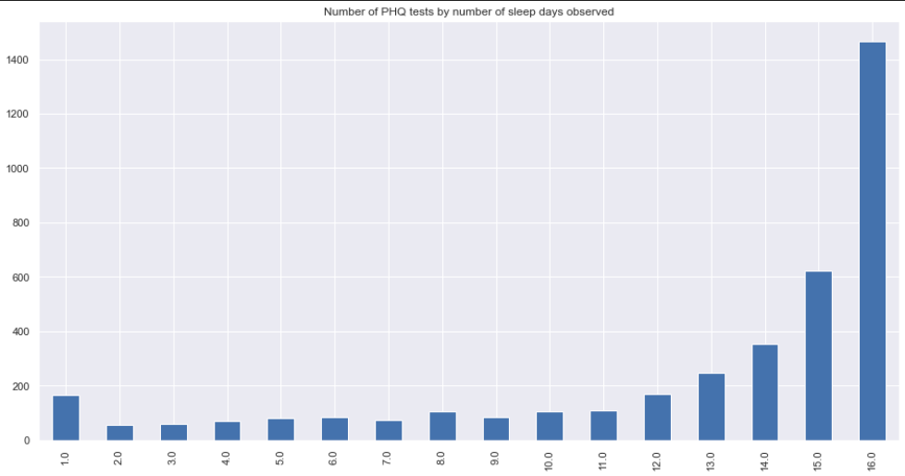
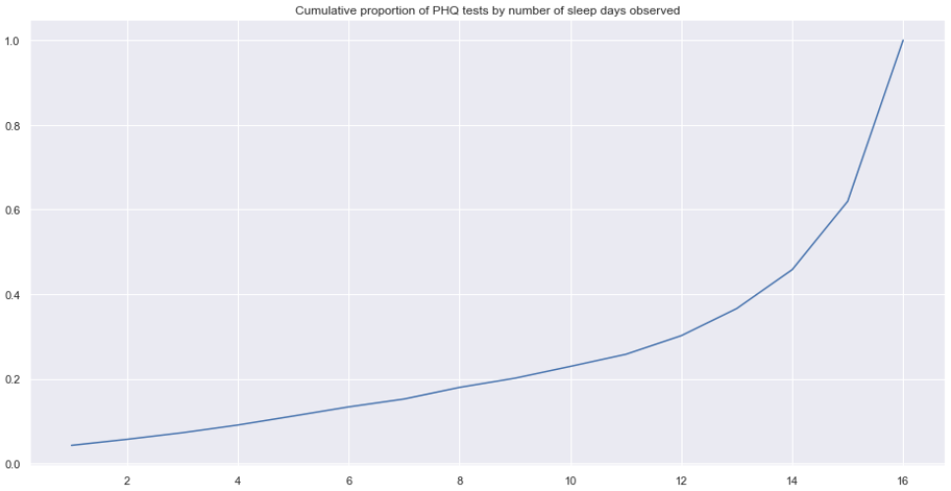
Is number of days observed associated with PHQ score?
EDA
MSc Project • 2022.04.11 updates

Slide 29
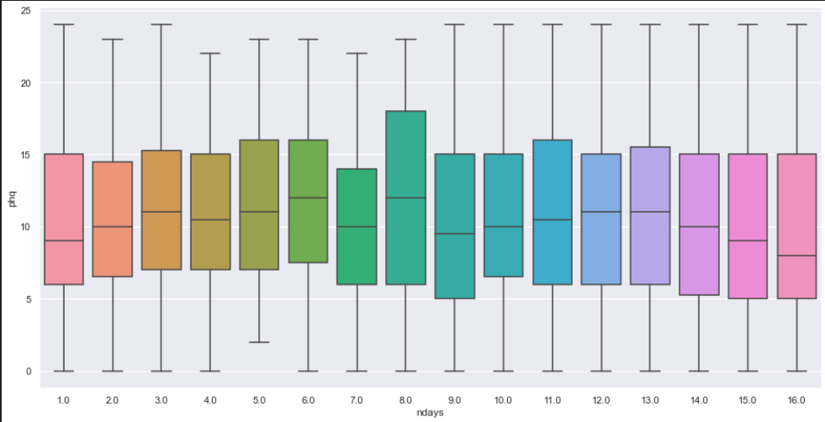
No association between number of days observed and PHQ score
EDA
MSc Project • 2022.04.11 updates

Slide 30

Nuances: (1) Sorting order (2) Number of nights included
Preprocessing
Nuances:
Maximum number of days observed = 16
Example:
PHQ date done on 22 Oct
Earliest sleep stage 7 Oct 00:01 (16 nights before)
Latest sleep stage 22 Oct 23:59 (data ‘leakage’ assuming PHQ test done before midnight)
16
15
14
15
14
8
3
7
2
2
1
1
MSc Project • 2022.04.11 updates

Slide 31
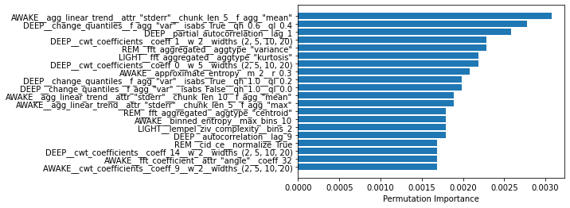
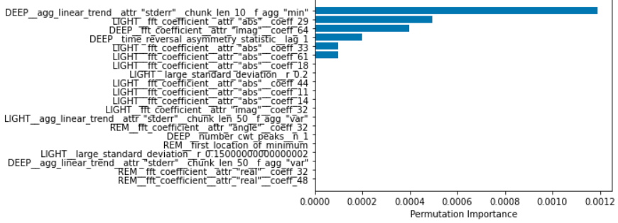
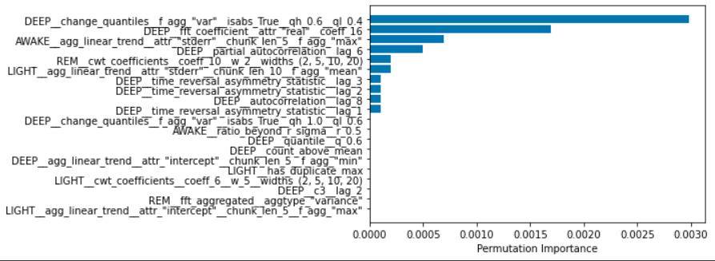
Feature importance from RF
Baseline models
MSc Project • 2022.04.11 updates

Slide 32
1am | 2am | 3am | 4am
>1 | 0
------------------- ======

Slide 33
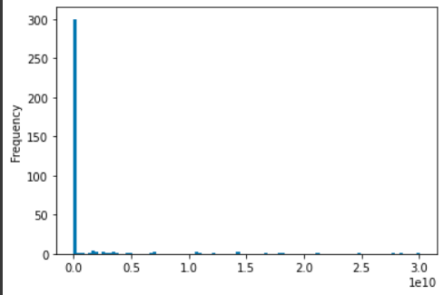
VIF on the train set
Feature selection
54/390 features with Infinite VIF
81/390 features with VIF<5
MSc Project • 2022.04.11 updates

Slide 34
Outline
Outline
Findings
Leakage in previous training
Discussions
Time-dynamic warping
Future directions
Feature selection with Recursive feature elimination
CNN on
Some questions:
What makes a good project?
Sleep stage time series [epoch=30s]
Binned time series [epoch=1h]
⤸ Feature extraction
Features
⤸ Feature selection
Selected features
⤸ Processing
Modelling
MSc Project • 2022.05.06 updates

Slide 35
Dynamic time warping
(1) Use KNN on binned time series, but use DTW as distance metric
(2) Employ DTW as feature extraction to derive metrics for assessing inter-night similarity
Sleep stage time series [epoch=30s]
Binned time series [epoch=1h]
⤸ Feature extraction by tsfresh
Features
⤸ Feature selection
Selected features
⤸ Processing
Modelling
MSc Project • 2022.05.06 updates

Slide 36
Feature selection
Sleep stage time series [epoch=30s]
Binned time series [epoch=1h]
⤸ Feature extraction
Features
⤸ Feature selection
Selected features
⤸ Processing
Modelling
MSc Project • 2022.05.06 updates

Slide 37
Outline
Outline
Unsupervised feature extraction by tsfresh
Baseline classifiers including xgboost, light-GBM
Performance
Experimentation with different bin size

Slide 38
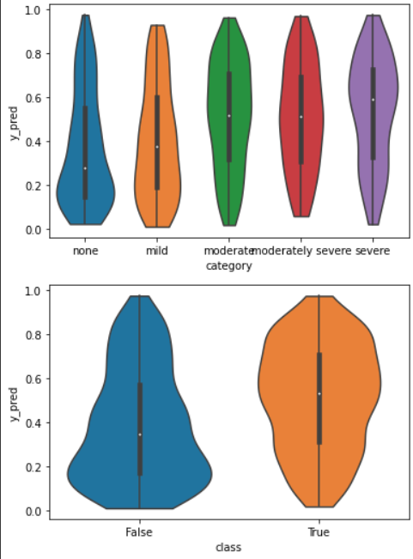
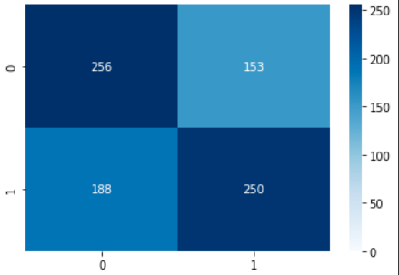
LightGBM on par with RF and xgboost
Unsupervised feature extraction by tsfresh
precision recall f1-score support
False 0.68 0.59 0.63 478
True 0.55 0.65 0.59 369
accuracy 0.61 847
From the violin plots, some information related to the depression severity is indeed captured
Not very strong discriminative ability
More robust towards multicollinearity
Left: LightBGM performance

Slide 39
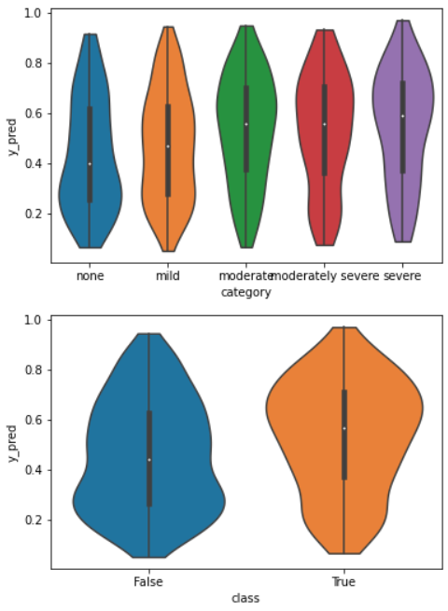
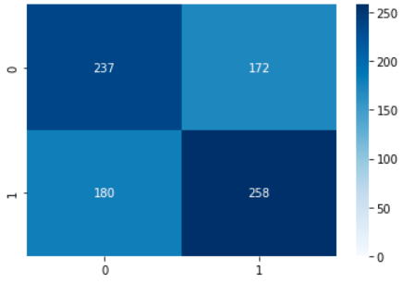
LightBGM performance rather unaffected after reducing to top 20 features
Unsupervised feature extraction by tsfresh
precision recall f1-score support
False 0.68 0.59 0.63 478
True 0.55 0.65 0.59 369
accuracy 0.61 847
precision recall f1-score support
False 0.58 0.57 0.57 417
True 0.59 0.60 0.59 430
accuracy 0.58 847
Left: LightBGM performance
Right: Performance after reducing to top 20 features
Features are ranked based on ‘p-values’
each feature vector is individually and independently evaluated with respect to its significance for predicting the target under investigation

Slide 40
Other classifiers after reducing to 15 features
Unsupervised feature extraction by tsfresh
all features 15 features
knn accuracy 0.574 0.6
svc accuracy 0.62 0.603
rf accuracy 0.626 0.62
logistic accuracy 0.593 0.609
lightbgm accuracy 0.61 0.58
each feature vector is individually and independently evaluated with respect to its significance for predicting the target under investigation

Slide 41
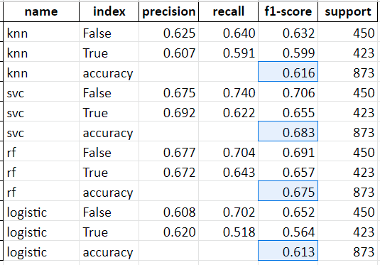
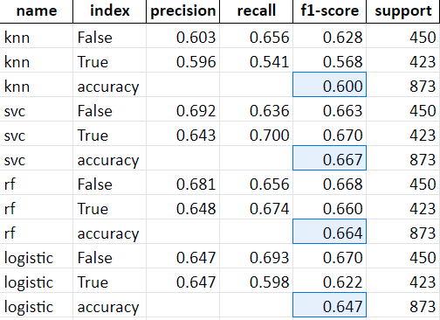
Experimenting with bin sizes
1h 30m 15m

Slide 42

RF feature importance (bin size=30m)

Slide 43


RF feature importance (bin size=15m)

Slide 44



Slide 45
Future directions
Clinically-informed features
DTW (intra-night similarity)

Slide 46
Leakage …?
Subject/Participant
Night
Nights
…
Sleep stage time series [epoch=30s]
Binned time series [epoch=1h]
Feature extraction
Features
Feature selection
Selected features
Processing
Modelling
MSc Project • 2022.05.06 updates

Slide 47


Slide 48

Sleep stage binning routine is fixed
Preprocessing
Total non-missing proportions (hourly) now <1 with no exceptions
No fix
Last meeting
Now
MSc Project • 2022.03.24 updates

Slide 49


Binning routine is fixed
Preprocessing
As expected, completely empty hours are usually in midnight (total non-missing proportion = 0)
Before filling with zeros
Filling with zeros
MSc Project • 2022.03.24 updates

Slide 50
Binning routine is fixed
Preprocessing
Zeroes are mostly filled to
MSc Project • 2022.03.24 updates

Slide 51
Best hyperparameters
### knn
Best score: 0.6361371153306452
Best params: {'knn__n_neighbors': 9}
### svc
Best score: 0.644029916331013
Best params: {'svc__C': 10, 'svc__gamma': 0.001, 'svc__kernel': 'rbf'}
### rf
Best score: 0.6363237836379443
Best params: {'rf__max_depth': 20, 'rf__max_features': 'auto', 'rf__min_samples_split': 2, 'rf__n_estimators': 200}
### logistic
Best score: 0.6189314284232641
Best params: {'logistic__C': 0.1, 'logistic__penalty': 'l1', 'logistic__solver': 'liblinear'}

